Slide 1
Network Computing

Slide 2
DATA COMMUNICATIONS
The term telecommunication means communication at a distance.
The word data refers to information presented in whatever form is agreed upon by the parties creating and using the data.
Data communications are the exchange of data between two devices via some form of transmission medium such as a wire cable.

Slide 3
Five components of data communication

Slide 4
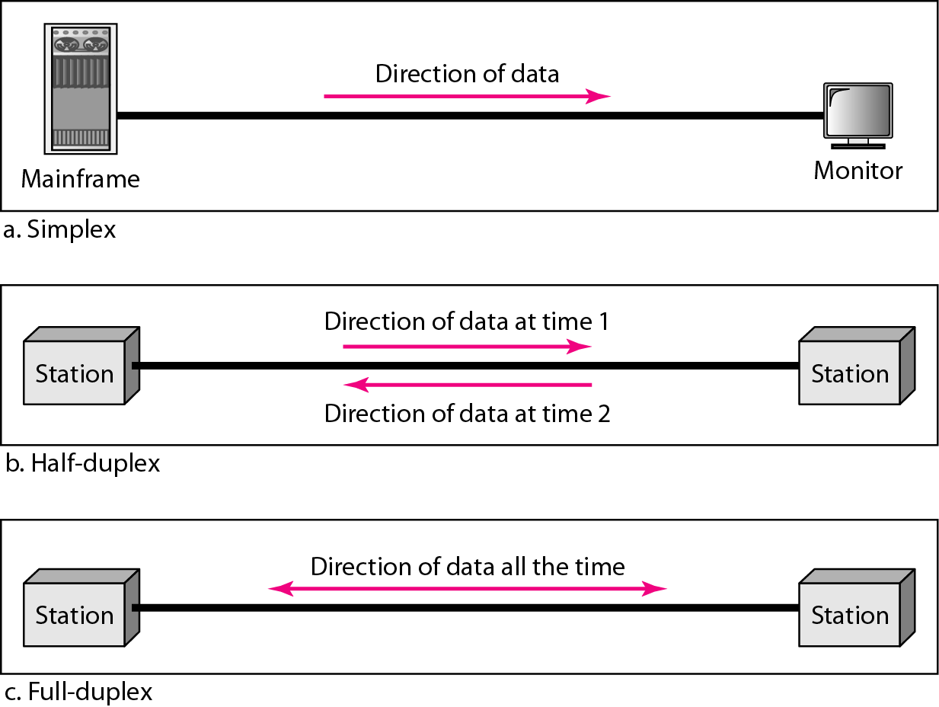
Data flow (simplex, half-duplex, and full-duplex

Slide 5
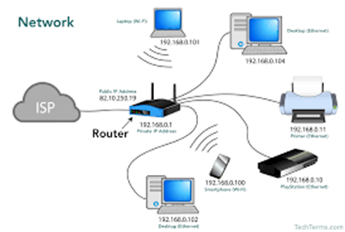
Network
A network is a collection of computers, servers, mainframes, network devices, peripherals, or other devices connected to one another to allow the sharing of data. An excellent example of a network is the Internet, which connects millions of people all over the world.

Slide 6
Advantages
Computer networks have become invaluable to organizations as well as individuals. Some of its main advantages are as follows −
Information and Resource Sharing − Computer networks allow organizations having units which are placed apart from each other, to share information in a very effective manner. Programs and software in any computer can be accessed by other computers linked to the network. It also allows sharing of hardware equipment, like printers and scanners among varied users.
Retrieving Remote Information − Through computer networks, users can retrieve remote information on a variety of topics. The information is stored in remote databases to which the user gains access through information systems like the World Wide Web.

Slide 7
Advantages
Speedy Interpersonal Communication − Computer networks have increased the speed and volume of communication like never before. Electronic Mail (email) is extensively used for sending texts, documents, images, and videos across the globe. Online communications have increased by manifold times through social networking services.
E-Commerce − Computer networks have paved way for a variety of business and commercial transactions online, popularly called e-commerce. Users and organizations can pool funds, buy or sell items, pay bills, manage bank accounts, pay taxes, transfer funds and handle investments electronically.

Slide 8
Advantages
Highly Reliable Systems − Computer networks allow systems to be distributed in nature, by the virtue of which data is stored in multiple sources. This makes the system highly reliable. If a failure occurs in one source, then the system will still continue to function and data will still be available from the other sources.
Cost–Effective Systems − Computer networks have reduced the cost of establishment of computer systems in organizations. Previously, it was imperative for organizations to set up expensive mainframes for computation and storage. With the advent of networks, it is sufficient to set up interconnected personal Types of network computers (PCs) for the same purpose.

Slide 9
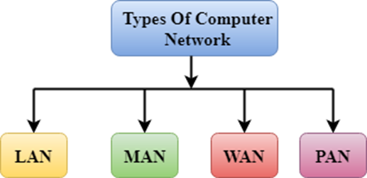
Types of Computer Network
There are mainly four types of computer networks:
Local Area Network (LAN)
Metropolitan Area Network (MAN)
Wide area Network (WAN)
Virtual Private Network(VPN)
VPN

Slide 10
Local Area Network(LAN)
A LAN is a network that is used for communicating among computer devices, usually within an office building or home.
LAN’s enable the sharing of resources such as files or hardware device that may be needed by multiple users. Is limited in size, typically spanning a few hundred meters, and no more than a mile.
Requires little wiring ,typically a single cable connecting to each device.
Has lower cost compared to MAN’s or WAN’s.
LAN’s can be either wired or wireless. Twisted pair, coax or fiber optic cable can be used in wired LAN’s.

Slide 11
Local Area Network(LAN)
Local area network is a group of computers connected with each other in a small places such as school, hospital, apartment etc.
LAN is secure because there is no outside connection with the local area network thus the data which is shared is safe on the local area network and can’t be accessed outside.
LAN due to their small size are considerably faster, their speed can range anywhere from 100 to 100Mbps.
LANs are not limited to wire connection, there is a new evolution to the LANs that allows local area network to work on a wireless connection.

Slide 12
Wide Area Network (WAN)
WAN covers a large geographic area such as country, continent or even whole of the world.
A WAN is two or more LANs connected together. The LANs can be many miles apart.
To cover great distances, WANs may transmit data over leased high speed phone lines or wireless links such as satellites.
Multiple LANs can be connected together using devices such as bridges, routers, or gateways, which enables them to share data.
The world’s most popular WAN is the Internet.

Slide 13
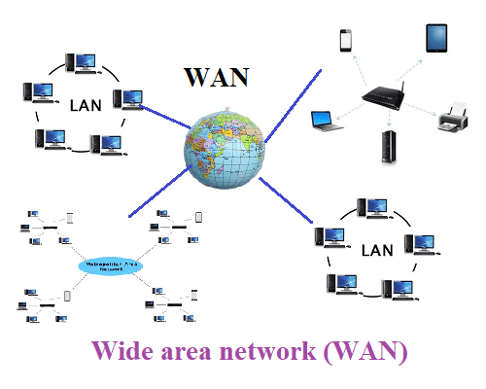

Slide 14
Metropolitan Area Network (MAN)
A metropolitan area network (MAN) is a large computer network that usually spans a city or a large campus.
A MAN is optimized for a larger geographical area than a LAN, ranging from several blocks of buildings to entire cities.
A MAN might be owned and operated by a single organization, but it usually will be used by many individuals and organizations.
A MAN typically covers an area of between 5 and 50 km diameter.
Examples of MAN: Telephone company network that provides a high speed DSL to customers and cables TV network.

Slide 15
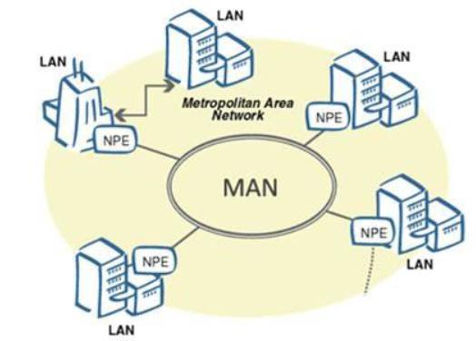

Slide 16
Virtual Private Network(VPN)
A VPN is a network that is used for communicating among computers and computer devices (including telephones) in close proximity of around a few meters within a room
It can be used for communicating between the devices themselves, or for connecting to a larger network such as the internet.
VPN’s can be wired or wireless.
The reach of a VPN is typically a few meters.

Slide 17
Enterprise Networking
Enterprise network is an organization’s interconnected network of multiple LANs and also can include multiple WANs.
Backbone networks are corporate high-speed central networks to which multiple smaller networks such as LANs called embedded LANs and smaller WANs connect.

Slide 18
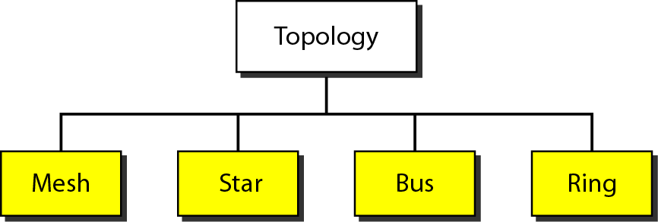
Network Topology
Network topology is the arrangement of the elements of a communication network.

Slide 19
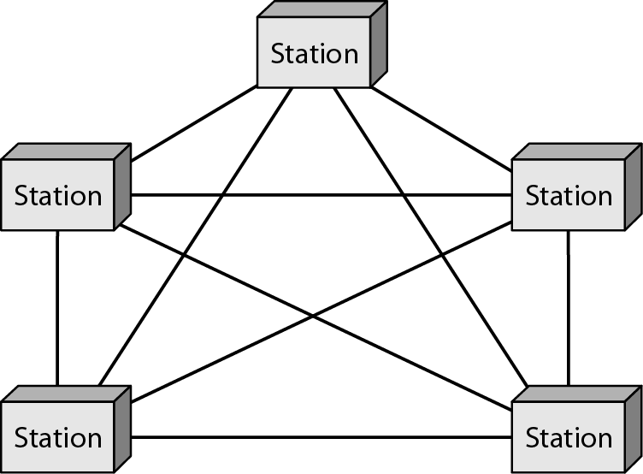
Mesh Topology
In mesh topology each device is connected to every other device on the network through a dedicated point-to-point link. When we say dedicated it means that the link only carries data for the two connected devices only.

Slide 20
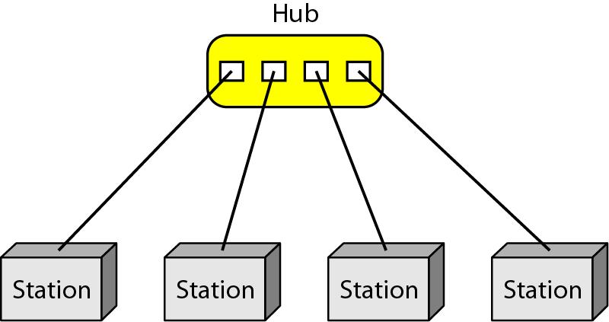
Star Topology
Star, all network nodes connect to a single computer, typically the file server.

Slide 21
Bus Topology
Bus, all network nodes connect to the bus, which is a single communications channel, such as twisted pair, coaxial cables, or fiber optic cable.

Slide 22
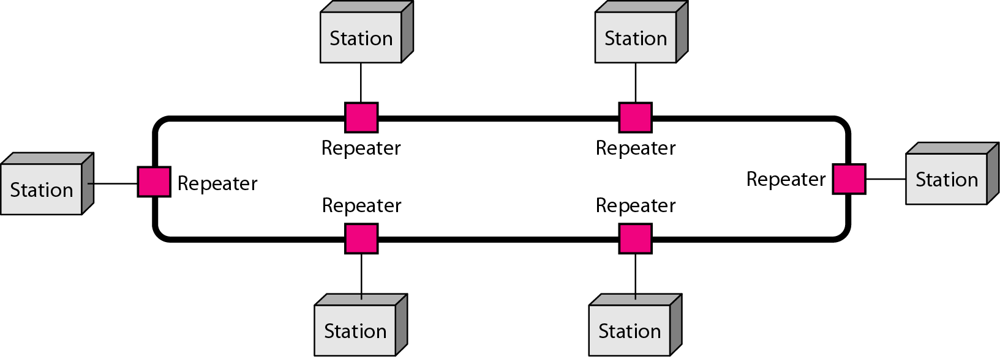
Ring Topology
Ring, network nodes are connected to adjacent nodes to form a closed loop.

